Slide 1
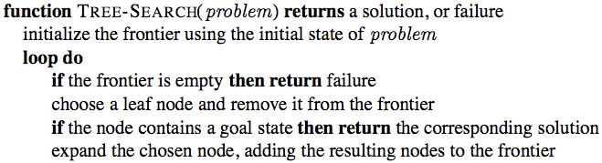
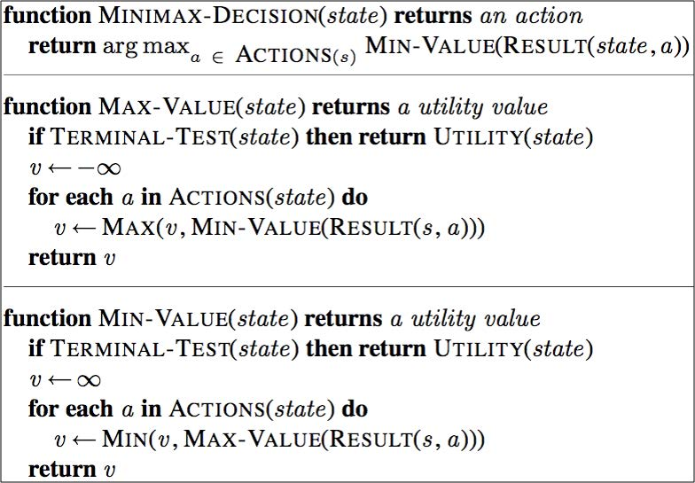
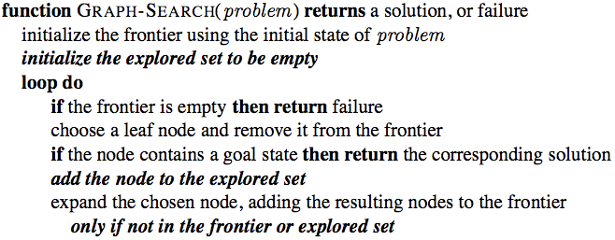
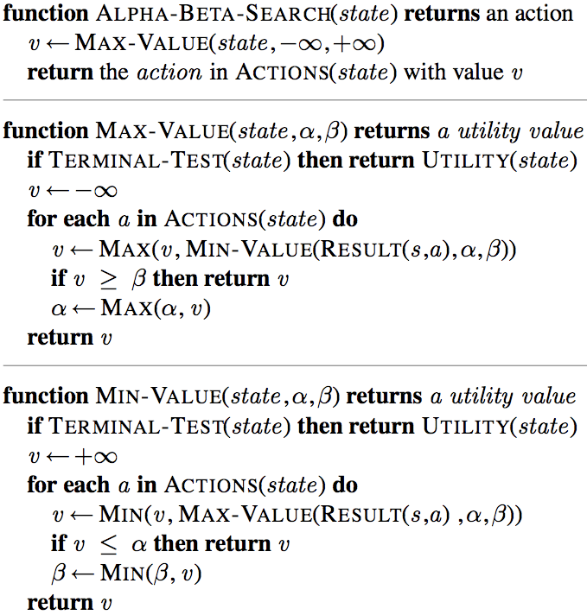
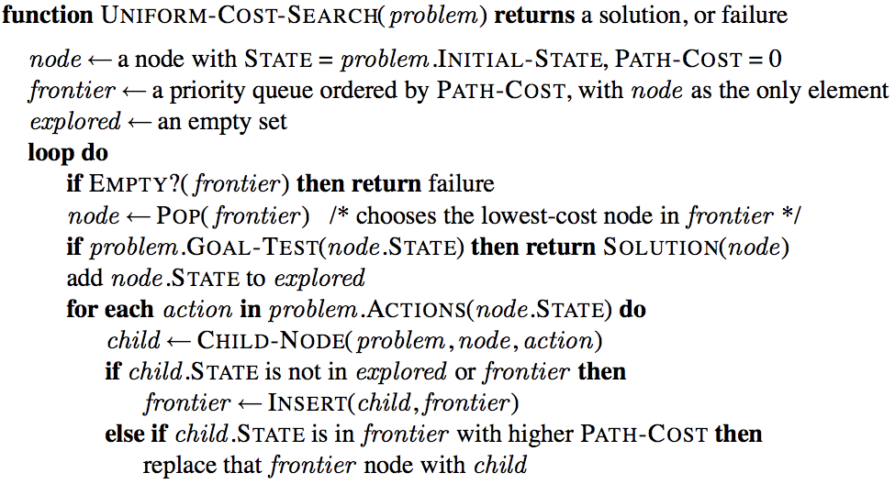
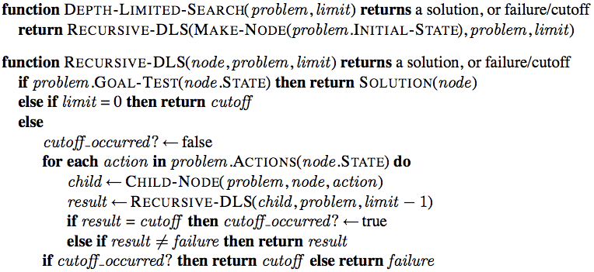

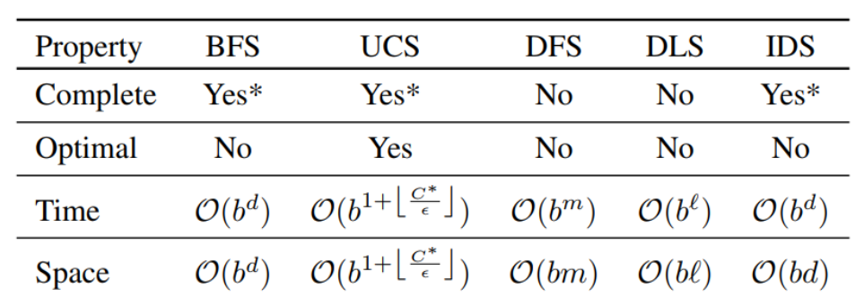
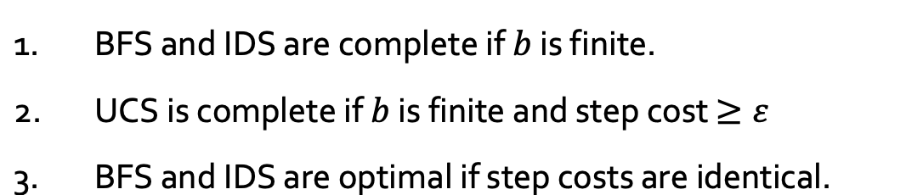
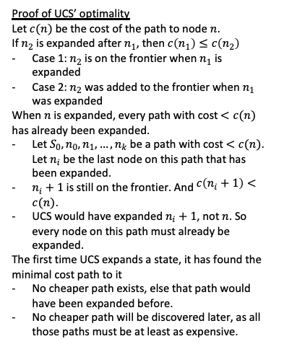
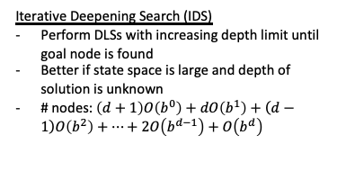
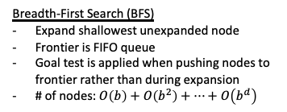
Tree and Graph Search Algo
Start at initial state, keep searching till reaching a goal state
Frontier: nodes that we have seen but haven’t explored yet. At initialisation, frontier is just the source.
At each iteration, choose a node from frontier, explore it, and add its neighbours to frontier
Graph search: a node that’s been explored once will not be revisited.
A state: represents a physical config
A node: a data structure constituting part of search tree. It includes state, parent node, action, and path cost g(n).
2 diff nodes can contain the same world state.
Proof of UCS’ optimality
Let $c(n)$ be the cost of the path to node $n$.
If $n_{2}$ is expanded after $n_{1}$, then $c\left(n_{1}\right)≤c\left(n_{2}\right)$
Case 1: $n_{2}$ is on the frontier when $n_{1}$ is expanded
Case 2: $n_{2}$ was added to the frontier when $n_{1}$ was expanded
When $n$ is expanded, every path with cost $<c(n)$ has already been expanded.
Let $S_{0},n_{0},n_{1}, …, n_{k}$ be a path with cost $<c(n)$. Let $n_{i}$ be the last node on this path that has been expanded.
$n_{i}+1$ is still on the frontier. And $c\left(n_{i}+1\right)<c(n)$.
UCS would have expanded $n_{i}+1$, not $n$. So every node on this path must already be expanded.
The first time UCS expands a state, it has found the minimal cost path to it
No cheaper path exists, else that path would have been expanded before.
No cheaper path will be discovered later, as all those paths must be at least as expensive.
Search problem params
b: branching factor
d: depth of shallowest goal node
m: maximum depth of search tree (may be inf)
Uninformed Search
Breadth-First Search (BFS)
Expand shallowest unexpanded node
Frontier is FIFO queue
Goal test is applied when pushing nodes to frontier rather than during expansion
# of nodes: $O\left(b\right)+O\left(b^{2}\right)+⋯+O\left(b^{d}\right)$
BFS | Goal node is near root Tree is deep but goals are rare
DFS | Goal node is very deep or all goal nodes are at the same depth Better space complexity than BFS
UCS | If cost is known/non-uniform and optimality is a requirement Equivalent to BFS if step costs are uniform
LDFS | If we know at what depth the goal node is
IDS | Like a fusion of BFS and DFS Some overhead (1/(b-1))
Uniform-Cost Search (UCS)
Expand least-path-cost unexpanded node
Frontier is PQ ordered by path cost
Equivalent to BFS if all step costs are equal
Depth-First Search (DFS)
Expand least-deepest unexpanded node
Frontier is LIFO stack
Depth-Limited Search (DLS)
Run DFS with depth limit l
Solving Problems by Searching
Iterative Deepening Search (IDS)
Perform DLSs with increasing depth limit until goal node is found
Better if state space is large and depth of solution is unknown
# nodes: $\left(d+1\right)O\left(b^{0}\right)+dO\left(b^{1}\right)+\left(d−1\right)O\left(b^{2}\right)+⋯+2O\left(b^{d−1}\right)+O\left(b^{d}\right)$
Define search problem
State space (should be partial-valid)
Initial state
Goal state(s) / goal test
Actions(s) returns actions available to agent at s
Transition model Result(s, a) returns next state
Action cost function Action-Cost(s, a, s’)
Path cost
Formulating problems: modelling the search problem through abstraction
Note: assume goal exists at finite depth

Slide 2
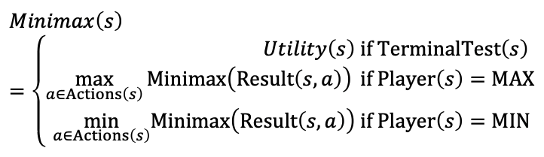
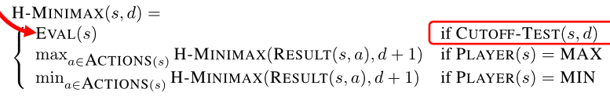
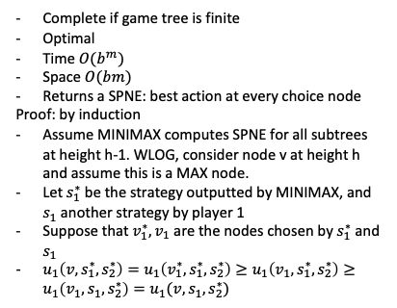
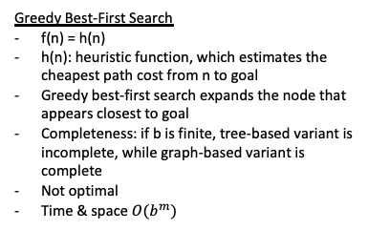
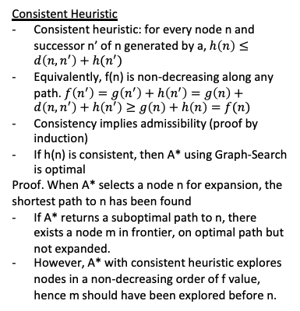
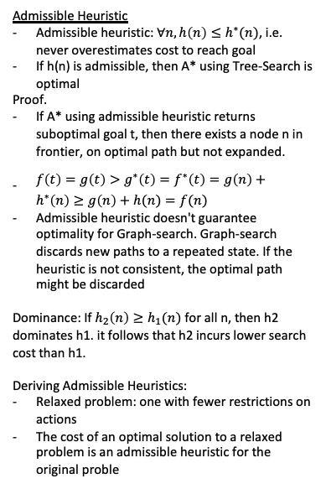
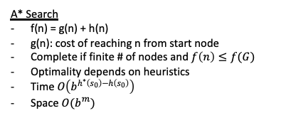
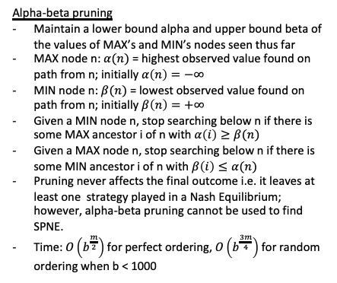
Informed Search
Consistent Heuristic
Consistent heuristic: for every node n and successor n’ of n generated by a, $h\left(n\right)≤d\left(n, n^{′}\right)+h(n^{′})$
Equivalently, f(n) is non-decreasing along any path. $f\left(n^{′}\right)=g\left(n^{′}\right)+h\left(n^{′}\right)=g\left(n\right)+d\left(n, n^{′}\right)+h\left(n^{′}\right)≥g\left(n\right)+h\left(n\right)=f(n)$
Consistency implies admissibility (proof by induction)
If h(n) is consistent, then A* using Graph-Search is optimal
Proof. When A* selects a node n for expansion, the shortest path to n has been found
If A* returns a suboptimal path to n, there exists a node m in frontier, on optimal path but not expanded.
However, A* with consistent heuristic explores nodes in a non-decreasing order of f value, hence m should have been explored before n.
Winning Strategy
Let Vmax be the set of nodes controlled by the MAX player and Vmin be the set of nodes controlled by the MIN player.
A strategy for the MAX player is a mapping s1 : Vmax → V ; similarly, a strategy for the MIN player is a mapping s2 : Vmin → V.
A strategy s1* for player 1 is called winning if for any strategy s2 by player 2, the game ends with player 1 as the winner.
The leaves of the minimax tree are payoff nodes. There is a payoff a(v) ∈ R associated with each payoff node v. More formally, the utility of the MAX player from v is umax(v) = a(v) and the utility of the MIN player is umin(v) = −a(v). The utility of a player from a pair of strategies s1 ∈ S1,s2 ∈ S2 is simply the utility they receive by the leaf node reached when the strategy pair (s1 , s2 ) is played.
Alpha-beta pruning
Maintain a lower bound alpha and upper bound beta of the values of MAX’s and MIN’s nodes seen thus far
MAX node n: $α(n)$ = highest observed value found on path from n; initially $α\left(n\right)=−∞$
MIN node n: $β(n)$ = lowest observed value found on path from n; initially $β\left(n\right)=+∞$
Given a MIN node n, stop searching below n if there is some MAX ancestor i of n with $α\left(i\right)≥β(n)$
Given a MAX node n, stop searching below n if there is some MIN ancestor i of n with $β\left(i\right)≤α(n)$
Pruning never affects the final outcome i.e. it leaves at least one strategy played in a Nash Equilibrium; however, alpha-beta pruning cannot be used to find SPNE.
Time: $O\left(b^{\frac{m}{2}}\right)$ for perfect ordering, $O\left(b^{\frac{3m}{4}}\right)$ for random ordering when b < 1000
Best-First Search
Use evaluation function f(n) as a cost estimate
Frontier: PQ ordered by non-decreasing cost f
Greedy Best-First Search
f(n) = h(n)
h(n): heuristic function, which estimates the cheapest path cost from n to goal
Greedy best-first search expands the node that appears closest to goal
Completeness: if b is finite, tree-based variant is incomplete, while graph-based variant is complete
Not optimal
Time & space $O(b^{m})$
A* Search
f(n) = g(n) + h(n)
g(n): cost of reaching n from start node
Complete if finite # of nodes and $f\left(n\right)≤f(G)$
Optimality depends on heuristics
Time $O\left(b^{h^{∗}\left(s_{0}\right)−h\left(s_{0}\right)}\right)$
Space $O(b^{m})$
Local Search
Optimal Strategy at Node - Minimax
MAX chooses move to maximize the minimum payoff
MIN chooses move to minimize the maximum payoff
Evaluation function and cut-off test
Evaluation function: estimated expected utility of state
Cut-off test: depth limit
Heuristic minimax value: run minimax until depth d, then start evaluation function to choose nodes
The path to goal is irrelevant; the goal state itself is the solution
State space: set of complete configs
Find final configs satisfying constraints
Local search algo: maintain single current best state and try to improve it
Advantages: very little/constant memory, and can find reasonable solutions in large state space
Admissible Heuristic
Admissible heuristic: $∀n, h\left(n\right)≤h^{∗}(n)$, i.e. never overestimates cost to reach goal
If h(n) is admissible, then A* using Tree-Search is optimal
Proof.
If A* using admissible heuristic returns suboptimal goal t, then there exists a node n in frontier, on optimal path but not expanded.
$f\left(t\right)=g\left(t\right)>g^{∗}\left(t\right)=f^{∗}\left(t\right)=g\left(n\right)+h^{∗}\left(n\right)≥g\left(n\right)+h(n)=f(n)$
Admissible heuristic doesn't guarantee optimality for Graph-search. Graph-search discards new paths to a repeated state. If the heuristic is not consistent, the optimal path might be discarded
Dominance: If $h_{2}\left(n\right)≥h_{1}(n)$ for all n, then h2 dominates h1. it follows that h2 incurs lower search cost than h1.
Deriving Admissible Heuristics:
Relaxed problem: one with fewer restrictions on actions
The cost of an optimal solution to a relaxed problem is an admissible heuristic for the original proble
Complete if game tree is finite
Optimal
Time $O(b^{m})$
Space $O(bm)$
Returns a SPNE: best action at every choice node
Proof: by induction
Assume MINIMAX computes SPNE for all subtrees at height h-1. WLOG, consider node v at height h and assume this is a MAX node.
Let $s_{1}^{∗}$ be the strategy outputted by MINIMAX, and $s_{1}$ another strategy by player 1
Suppose that $v_{1}^{∗},v_{1}$ are the nodes chosen by $s_{1}^{∗}$ and $s_{1}$
$u_{1}\left(v,s_{1}^{∗},s_{2}^{∗}\right)=u_{1}\left(v_{1}^{∗}, s_{1}^{∗},s_{2}^{∗}\right)≥u_{1}\left(v_{1},s_{1}^{∗},s_{2}^{∗}\right)≥u_{1}\left(v_{1},s_{1},s_{2}^{∗}\right)=u_{1}(v,s_{1},s_{2}^{∗})$
Hill-climbing search
if highest-valued successor if better than current, update current.
Always terminate with a solution
Problem: can get stuck in local maximum
Non-guaranteed fixes: sideway moves, random restarts
Adversarial Search aka Games
Game: Problem Formulation
Initial state
States
Players: Player(s) defines which player has the move in state s
Actions: Actions(s) returns the set of legal moves in s
Transition model: Result(s, a)
Terminal test Terminal(s) == true iff game end
Utility function Utility(s, p): final numeric value for a game that ends in terminal state s for player p

